Slide 1
UNIT-5 PART-II
By
Dr. K. Shahu Chatrapati
Professor & Controller of Examinations

Slide 2
1. Hardware Limitations and Integration in Mobile Devices:
Mobile devices are limited by the size of input and output data, influencing the size of components like keyboards and displays.
Current integration trends suggest future devices may have displays as wristbands or head-mounted and input methods integrated into clothes or accessories.

Slide 3
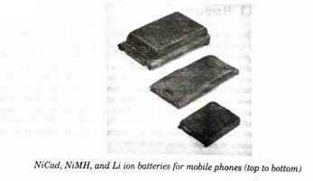
1.1. Battery Evolution:
Battery technology in mobile devices has evolved from NiCad to lithium-ion and lithium polymer, offering lighter weight and higher energy density.
Innovations like lithium polymer use gel electrolytes and flexible layers, which do not require rigid, leak-proof casing, allowing for varied battery shapes and sizes.

Slide 4
1.2 Display Technology
LCDs are being replaced by lighter and more power-efficient technologies like OLED and light-emitting polymer, which allow for thinner, more flexible displays that can be built to almost any size and shape, enhancing portable device usability and aesthetic flexibility.

Slide 5
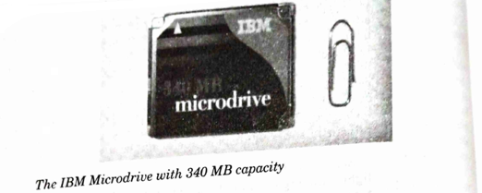
1.3 Memory
Mobile device memory is becoming cheaper and more integrated, with technologies like flash and non-volatile RAM allowing for more storage capacity without increasing device size, enabling the handling of larger data like digital images and multimedia content efficiently

Slide 6
1.4 Processor
Processor Evolution: Increases in processor clock rates and advancements in CMOS manufacturing have led to smaller, more powerful microprocessors, enhancing the computational capabilities of mobile devices without significantly increasing power consumption.

Slide 7
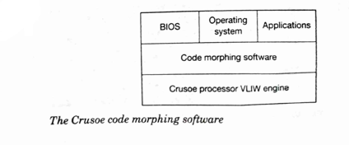
Advanced Processor Technologies and Power Management:
Intel's SpeedStep technology enhances power management by allowing processors to adjust core voltage and clock frequencies according to the power availability and operational demand.
This helps in reducing heat emissions and enabling high performance even with reduced power consumption.
The Crusoe processor uses software to emulate more conventional instruction sets, which allows it to operate with fewer transistors and lower power consumption.

Slide 8
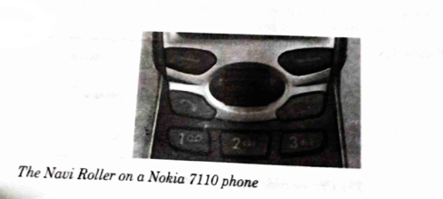
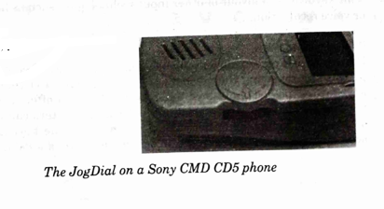
2. Human-Machine Interfaces in Mobile Devices:
Mobile devices typically use specialized keyboards and displays to interface with users, featuring smaller and fewer keys to fit the device’s form factor.
2.1
Navigation within these devices is often facilitated by integrated cursor keys or other specialized navigation tools like the Navi Roller and JogDial, which provide directional inputs and sometimes haptic feedback.

Slide 9
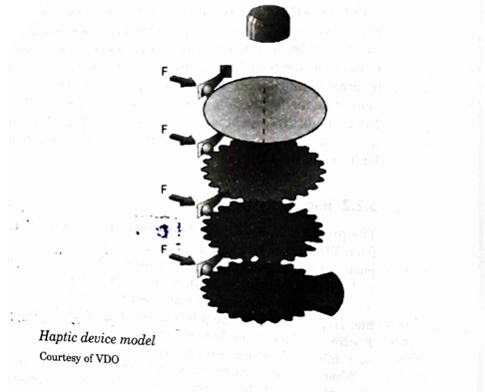
2.2 Haptic Interfaces:
Haptic technology in devices like the programmable rotating actuator with haptic feedback allows for a tactile response to user inputs, simulating mechanical reactions such as resistance or clicks.
These features enhance the user's interaction with the device by providing physical feedback for virtual actions.

Slide 10
2.3 Keyboard Technologies and Adaptations:
Mobile device keyboards vary significantly, from full QWERTY layouts to more condensed versions with limited keys to suit smaller devices or specific user environments. Some devices replace physical keys with on-screen keyboards to adapt to various user needs and contexts, including touch-sensitive displays that provide a more dynamic user interface.

Slide 11
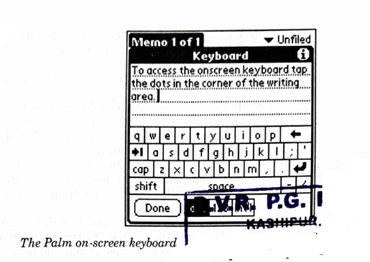
2.3.1 Palm On-screen Keyboard:
The layout of the Palm on-screen QWERTY keyboard is designed for easy text input on touch screens, with users accessing the keyboard by tapping specific areas on the screen.
It includes a full set of keys similar to those on a computer keyboard.

Slide 12
2.3.2 Fitaly Keyboard Layout:
The Fitaly keyboard layout is an alternative to the traditional QWERTY keyboard, optimized for stylus use.
It arranges letters based on frequency of use and transition probability in English to minimize the travel distance of the stylus during text input.
It supports efficient text input of accented characters and numbers through sliding techniques, allowing users to enter characters by moving the stylus in specific directions that correspond to different accents or numbers without switching keyboard modes.
Specific gestures used on the Fitaly keyboard for inputting accented letters and numbers involve directional movements of the stylus to select different accents or numerals, streamlining the input process for multilingual users.

Slide 13
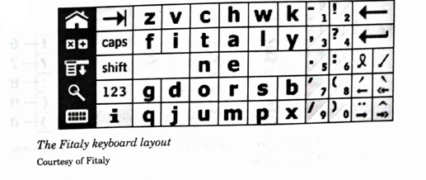
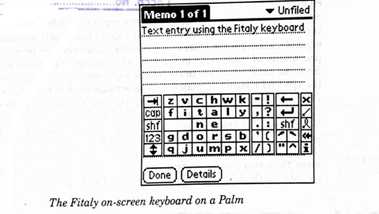
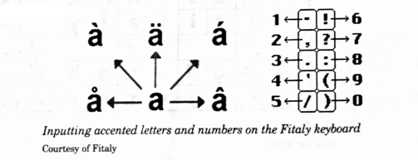

Slide 14
2.3.3 Text input methods and speech recognition:
Octave Input Method:
The Octave input method uses a special button on devices without touch-sensitive displays. This button can be moved into a limited number of positions to generate the equivalent of strokes needed for text entry, as shown in a prototype mobile phone.
Handwriting Recognition Technologies:
Technologies available for handwriting recognition vary in their processing power and precision requirements. The recognition of cursive handwriting is more complex than that of individually printed letters.

Slide 15
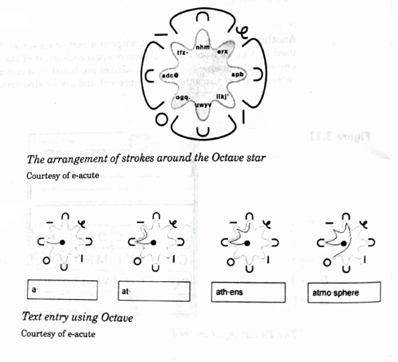

Slide 16
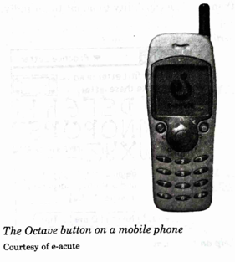
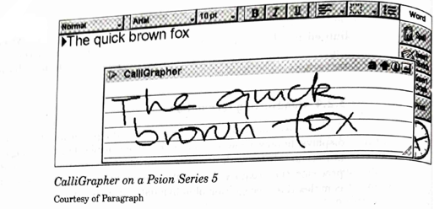
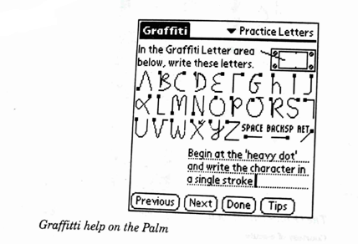

Slide 17
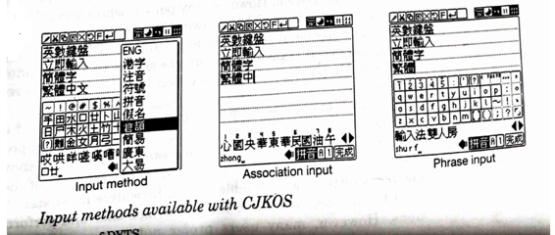

Slide 18
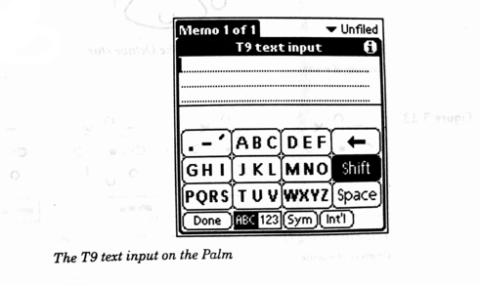
Word Recognition Challenges:
The most computing-intensive approach tries to recognize complete handwritten words. This natural method of writing is the most difficult for computers to recognize and requires precise data capture.
Character and Speech Recognition:
Other character recognition methods limit recognition to separated characters and require the stylus to be lifted between letters. Speech recognition is becoming viable with advances in computing power, making it possible to handle continuous speech which is natural for human interaction but challenging for devices due to the complexities of human language.

Slide 19
3. Biometrics
3.1 Biometric Authentication:
Biometric systems use unique personal characteristics, such as fingerprints, for authentication by capturing these traits with a sensor, extracting features, and comparing them to a stored reference. The system either confirms or denies the user's identity based on this comparison.
3.2 Fingerprint Authentication Method:
This method involves using a sensor to capture a fingerprint, extracting key features such as minutiae points, and then comparing these to a stored fingerprint template. This process is depicted in a diagram showing the stages of sensing, feature extraction, and comparison.

Slide 20
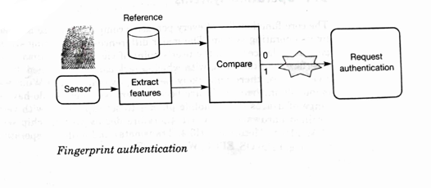

Slide 21
4. Operating Systems for Mobile Devices:
Pervasive devices rely on operating systems like Palm OS, EPOC, and Windows CE to manage tasks, user interactions, and network communications effectively. These systems are optimized for performance on mobile hardware with limited resources.
4.1 Palm OS Features:
Palm OS is described as having a microkernel architecture that supports a range of applications and manages memory, system events, and communications effectively.
It's designed to operate efficiently on devices with minimal processing power and storage.

Slide 22
Power management: Palm OS includes various operation modes such as sleep and doze to conserve battery life.
OS Size: The size of Palm OS 3.5 is approximately 1.4 MB, including built-in applications, requiring up to 64 KB of runtime memory for operations including TCP/IP.
User Interface: The Palm OS user interface is designed to facilitate ease of use with minimal taps and includes an application starter and built-in date book visual representation. It focuses on simplicity with one-button access to applications and a minimalistic approach to taps required for operations.

Slide 23
4.2 EPOC
EPOC Development: EPOC supports programming in C++, Java, and OPL, with C++ being the preferred choice for system development and high-performance applications. Development environments include GNU for C++, Microsoft Visual C++ for compilation, and a Java runtime environment for application development.
EPOC Development Cycle: The development process for EPOC applications involves editing the code on a PC, compiling it for EPOC, running and debugging it, then cross-compiling to load onto an EPOC device. This cycle ensures applications are fully tested before deployment.
Multitasking on EPOC: EPOC applications can be either synchronous, resembling Palm OS applications, or asynchronous, which do not block the processor and can receive inputs from other processes, allowing for efficient multitasking and power management.

Slide 24
4.3 Windows CE
Security Features:
Cryptographic Support: Windows CE incorporates the Cryptographic Application Programming Interface (CAPI), which facilitates the secure storage of information within the device. The system uses public-key signatures to authenticate kernel loaders and prevent unauthorized applications from executing.
Smart Card Storage: Sensitive data can be securely stored on smart cards. The data stored on these cards is accessible only through the use of a kernel-loader authentication program that utilizes public-key signatures, enhancing the security against unauthorized access.

Slide 25
Software Development:
Development Environment: Windows CE is built on the Win32 API, which provides significant benefits for developers familiar with Windows programming. The environment supports various programming languages including C++ and Visual Basic.
Tools and JVMs: The platform supports professional development tools like Visual C++ or Visual Basic. Additionally, there are Java Virtual Machines (JVMs) available for Windows CE, including the KVM (Java 2 Micro Edition) and others from third parties, which facilitate the development and management of applications.

Slide 26
4.4 QNX Neutrino
System Overview:
Real-Time Operating System: QNX Neutrino is designed for real-time applications, featuring a microkernel architecture that ensures high reliability and flexibility. It's suitable for environments where system stability and uptime are critical.
Modular Architecture: The core system is highly modular, with a small microkernel that manages interprocess communication, process scheduling, and interrupt dispatching. It’s designed to run with minimal overhead, occupying only 12 KB.

Slide 27
Core Functionality:
Resource Management: Resource managers in QNX Neutrino handle various system services such as file systems, network services, and graphical interfaces. These managers allow for modular upgrades and changes without system restarts.
Process Isolation: The microkernel design ensures that a failure in one part does not affect the entire system. This isolation improves system stability and security.

Slide 28
4.5 BeOS
System Features:
Optimized for Media: Originally designed for media applications, BeOS provides robust support for real-time multimedia processing. It’s optimized for performance in handling large files and multiprocessor tasks.
64-bit File System: BeOS includes a 64-bit file system capable of handling very large files, making it ideal for multimedia applications that require the manipulation of large data sets.

Slide 29
Multitasking and Memory Management:
Fine-Grained Multitasking: BeOS supports preemptive multitasking and multithreading, which allows it to manage multiple complex operations simultaneously without performance degradation.
Memory Protection: The operating system includes advanced memory management capabilities that protect data and program execution, ensuring that applications operate independently and securely.
Each operating system is tailored to specific types of devices and user needs, from embedded systems requiring real-time operations (QNX Neutrino) to multimedia-rich environments (BeOS), offering unique sets of features and development environments to cater to diverse application needs.

Slide 30
Software Development for BeOS
For software development on Intel versions of BeOS, developers can use a C/C++ GNU compiler and tools. An integrated C/C++ development environment by Metrowerks is also available, although BeOS may not be ideal for devices with strict memory constraints. BeOS allows for the use of a standard Java environment and is compatible with POSIX systems, allowing easier code reuse from Unix or QNX Neutrino.

Slide 31
4.6 Embedded Linux
Embedded Linux is tailored for devices where resource constraints and power efficiency are critical.
It utilizes a stripped-down Linux kernel, retaining the capabilities for multitasking and network management, which are critical for embedded systems.
Embedded Linux can be configured for various device needs and supports multitasking with both preemptive and real-time scheduling. Security features and system size can be adapted based on device requirements, with the kernel able to run with a minimal footprint.

Slide 32
QNX Neutrino
QNX Neutrino is designed for robust, real-time applications, featuring a microkernel architecture.
This allows it to operate reliably under conditions where system resources are strictly managed and where uptime and stability are crucial.
QNX supports POSIX standards, making it compatible with a broad range of software and programming environments

Slide 33
Summary of Operating Systems for Pervasive Devices
The text summarizes the diverse operating systems available for pervasive devices, each tailored to specific device needs.
Palm OS is noted for its simplicity and low power usage but lacks multitasking and security features.
EPOC, now part of the Symbian family, offers robust multitasking capabilities.
Windows CE is optimized for multimedia capabilities and includes support for real-time operations.
QNX is suited for environments requiring robust real-time operations.
BeOS is designed for multimedia applications, leveraging its ability to handle large amounts of data effectively.
These systems show the variability in operating systems designed for embedded and pervasive computing, each with unique strengths tailored to specific application needs and hardware configurations.

Slide 34
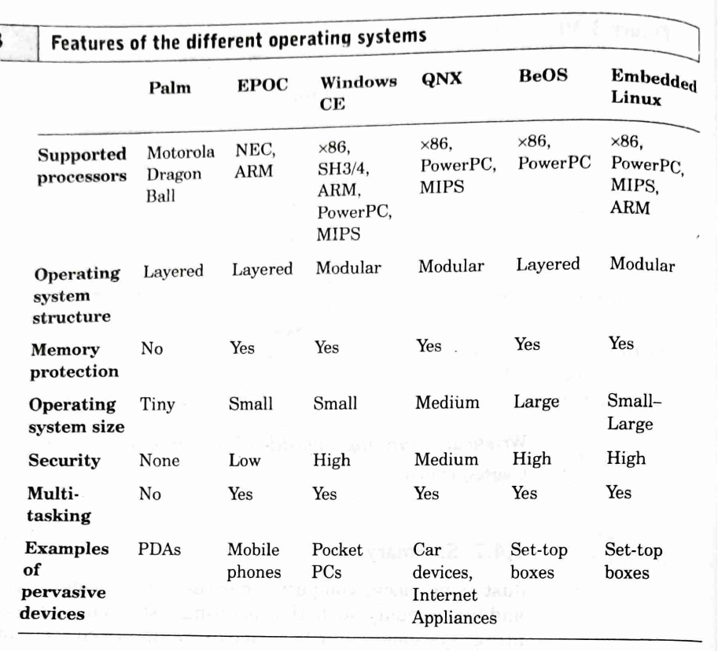

Slide 35
5. Java for Pervasive Devices:
Java offers a common platform for developing applications on pervasive devices with limited computing resources.
Versions of Java for Pervasive Devices:
Java Micro Edition (J2ME) and Java Standard Edition (J2SE), Origins of Java:
Java was initially developed in 1991 by James Gosling at Sun Microsystems under the project name "Green Project" and was originally called Oak.
Evolution of Java:
The programming language was renamed to Java and officially announced in 1995, initially focused on small computing devices and later expanded to broader applications including servers and mobile devices.
Java 2 Platform:
Current Java versions are grouped under Java 2 Platform, which includes J2ME for pervasive computing devices with specific APIs for mobile and embedded environments, and J2SE for traditional PCs optimized for performance and security.

Slide 36
Java Enterprise Edition (J2EE):
Designed by Sun specifically for server systems.
Enhances Java 2 Standard Edition (J2SE) with additional APIs for server-based computing like Java Beans, JSPs, and database access.
Java Virtual Machines (JVMs):
The base layer of the Java platform includes different JVMs for various devices:
Card VM for smart cards.
KVM for pervasive devices.
Standard VM and Client HotSpot VM for desktops.
HotSpot VM for high-performance server applications, which performs intelligent precompiling of frequently-used code fragments.
Compliance and Support:
All JVMs are compliant with the Java programming language definition.
KVM and Card VM support only subsets of the full Java programming definition.

Slide 37
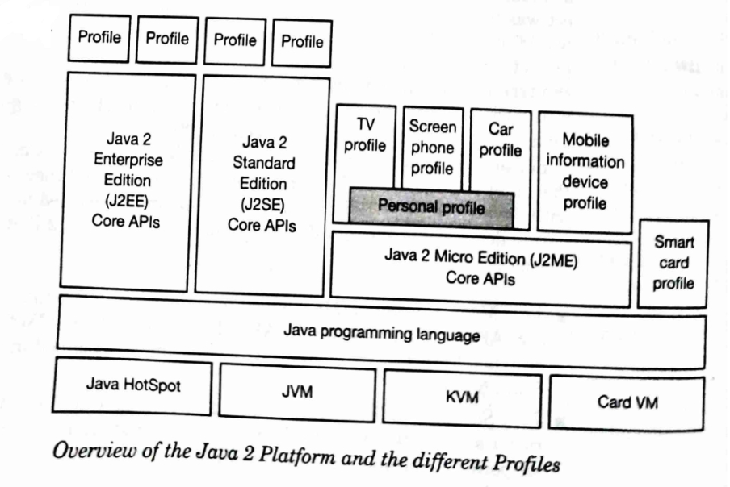

Slide 38
Core APIs and Profiles:
Different core APIs are layered on top of the JVMs for various Java editions.
Profiles are created to tailor Java editions for specific environments or device types, enhancing functionality for specific vertical markets or devices.
Profiles Include:
TV profile, Screen phone profile, Car profile, Mobile information device profile, Personal profile, and Smart card profile.
Configuration:
Defines the minimum Java technology libraries and virtual machine capabilities expected to be available across all devices.
5.2 Java 2 Micro Edition
Java 2 Micro Edition is designed for pervasive computing devices that generally do not have real-time requirements. These devices include smart cards, mobile phones, and set-top boxes.
Characteristics of Devices:
Limited memory availability (128–512 kB)
Battery-operated
Network connectivity
Restricted graphical display capabilities

Slide 39
Configurations:
Connected Device Configuration (CDC): Based on PersonalJava, targets devices like screen phones and set-top boxes with over 512 kB ROM and 256 kB RAM. It focuses on providing core Java APIs and has a restricted user interface library suited for devices with screens.
Connected, Limited Device Configuration (CLDC): Geared towards mobile phones and TV sets, this configuration supports basic applications with requirements for geographical user interface, data storage, messaging, security, and wireless networking within 128–512 kB RAM. It uses a special Virtual Machine (KVM) optimized for memory-constrained environments.
Enhancements:
Embedded Java: Allows customization of the Java platform for embedded devices by omitting unnecessary classes and VM features to minimize resource usage and cost.
Java Card: Tailors Java for very small devices with a special compressed bytecode format, suitable for devices like SIM cards and credit cards used in mobile phones.
Real-time Java: A specialized version of Java designed to meet the needs of real-time applications (detailed in section 5.3).

Slide 40
5.3 Real-time Java
Inadequacy of Standard Java for Real-Time Applications:
Standard Java does not provide predictable runtime behavior.
It lacks the capability for direct memory access and suffers from non-deterministic issues like garbage collection, which affect execution times.
Development of Real-Time Java (RTSJ):
To address these limitations, a collaboration of companies developed the Real-Time Specification for Java (RTSJ).
Companies involved include Aonix, Cyberonics, IBM, Microware Systems, Nortel Networks, QNX, Rockwell-Collins, and Sun.
The specification is still in its early phases, with a draft available and a reference implementation expected soon.

Slide 41
Features of Real-Time Java:
Predictable Execution Speed: A primary goal of RTSJ is to ensure predictable execution times, avoiding the pitfalls of standard Java.
Customizable Schedulers: RTSJ allows for the customization of schedulers, supporting schedulable objects in addition to tasks and threads.
Advanced Memory Management: RTSJ introduces different memory types to accommodate both short- and long-lived objects outside the regular garbage collection process. This includes scoped memory for data sharing between real-time and non-real-time tasks and physical memory support.
Compatibility and Design Objectives:
RTSJ is designed to be backward compatible with standard Java.
It aims to include all necessary features to support systems with stringent real-time requirements.

Slide 42
Additional Features of Real-time Java
Access to Physical Memory:
RTSJ provides mechanisms for Java to have direct access to the machine memory at specific sandboxed locations. This is crucial for applications that interact directly with physical sensors or actors, allowing them to read or write directly to memory.
Object and Thread Synchronization:
To handle the complex synchronization needs of real-time applications involving multiple threads, RTSJ offers synchronized wait-free read and write queues and monitors for mutual exclusion. This approach helps to avoid priority inversion issues common in standard Java implementations.
Asynchronous Event Handling:
Real-time systems often rely on event-driven architectures. RTSJ supports extensive use of asynchronous events such as interrupts, enhancing responsiveness and control transfers between objects and threads.

Slide 43
5.4 Java Virtual Machines for Pervasive Devices
Sun’s KVM:
Implements the J2ME standard and is designed for devices with more than 128 kB of memory, bridging the gap between PersonalJava VM and Java Card VM, which are aimed at devices with higher and lower memory capacities, respectively.
Waba VM:
Explained as using Java-like technology but with libraries optimized for faster execution and smaller memory footprints.
IBM VisualAge Micro Edition:
Provides a fully integrated development environment for Java on pervasive devices, including a virtual machine, which caters to the specific needs of these technologies.

Slide 44
KVM (Kilobyte Virtual Machine)
Memory Footprint: Requires 50-70 KB, needs 128 KB at runtime.
CPU Compatibility: Works on 16-bit processors at 16 MHz and on 32-bit processors.
Supported Platforms: Includes Palm OS, Solaris, and Windows32.
UI Classes: Does not support AWT or Swing, uses specialized native I/O drivers.
Restricted Features: Lacks features like multi-dimensional arrays, class file verification, RMI, thread grouping, and reflection.
Library Subset: Includes only parts of the J2SE libraries, such as java.net and java.io.
Availability: Development kit available, runs on over 20 platforms including Nokia, Sony, and Motorola phones, with upcoming support for EPOC OS.
5.5 Waba Programming Platform
Platform Components: Includes a VM, class file format, and base classes.
Java Compatibility: Similar to Java but not directly compatible; uses Java development tools for Waba programming.
Target Devices: Optimized for devices like Palm and Windows CE, runs Waba programs without requiring changes.

Slide 45
5.5 Waba Programming Platform Overview
Licensing: Waba is open-source, licensed under the GNU license, similar to Linux.
Software Development Kit (SDK): Includes reference documentation, Java classes, and tools for adapting applications to small devices. It also features bridge classes that facilitate the operation of Waba programs under Java, albeit with limited compatibility.
Java Compatibility: Syntax and semantics are similar to Java, but full compatibility is not achieved. Waba programs can be compiled using Java SDK and then translated to bytecodes suitable for the Waba VM using a tool called exegen.

Slide 46
Execution Environment: Executed by the Waba VM, which is initialized and configured by a device-specific launch program that also manages memory allocation.
Virtual Machine (VM) Specifications: The Waba VM executes a simplified subset of Java bytecode, tailored for devices with limited processing capabilities. It does not support complex data types like long and double, exceptions, or threading.
Memory Efficiency: Extremely low memory requirements, e.g., the complete Waba VM for Palm OS requires only about 60 kB.
Development Considerations: The Waba VM omits standard Java java.lang classes, substituting them with waba.lang equivalents to better fit the constrained device environments.

Slide 47
5.6 IBM's VisualAge Micro Edition J9 VM
Foundation for Embedded Systems: Serves as IBM’s embedded systems solution, offering a scalable approach to resource management across devices.
Library Versions: Ranges from minimal to fully featured to accommodate varying device resource requirements.
Library Configurations:
jclXtr: Minimal functionality with 92 kB of ROM/Flash.
jclCore: Essential functions using 344 kB of ROM/Flash.
jclGateway: Includes URL and security features, occupying 563 kB of ROM/Flash.
jclMax: Most extensive library with 2479 kB of ROM/Flash and RAM, including advanced security features.

Slide 48
Development Environment:
Supports JDK 1.2 compatible environments with a suite of platform-specific tools.
Available for Windows and Red Hat Linux; supports both local and remote debugging.
Features debugging capabilities like setting breakpoints and stepping through code.
Supported Platforms: Includes a variety of operating systems such as Windows, Linux, Palm OS, Neutrino, embedded Linux, and Windows CE.
Real-Time Debugging: Allows for immediate development and debugging on devices using TCP/IP connections, specifically highlighting the capability with Palm OS devices running the J9 VM.

Slide 49
5.7 VisualAge Integrated Development Environment
Code Versioning and Team Collaboration: VisualAge Micro Edition supports code versioning and includes a repository server for team working, enhancing collaborative efforts in software development.
Smart Linker: Includes a smart linker that creates a prelinked class file archive. This archive excludes all unused methods, optimizing the storage space required on the target device.
Optimization for Device ROMs: This environment is designed to facilitate the inclusion of Java applications in device ROMs, with capabilities to create ROM-able class archives.

Slide 50
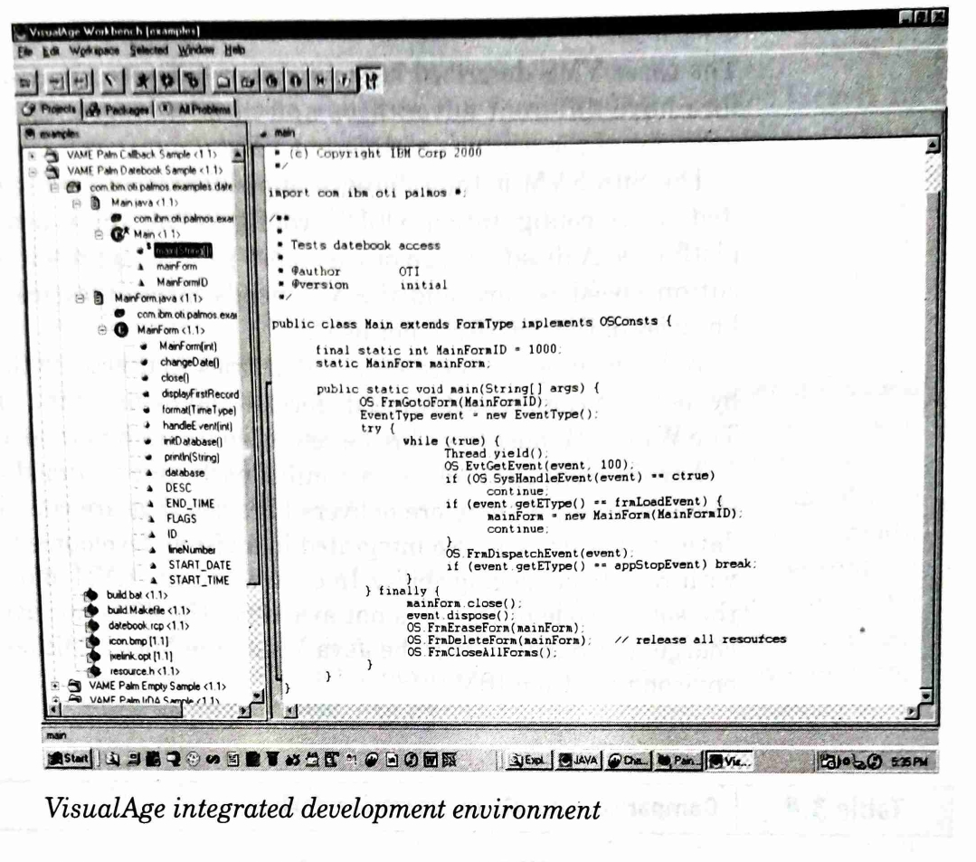

Slide 51
